Slide 1
Web Services
National Geospatial Management Center (NGMC)
September 27, 2012

Slide 2

Webinar Presenter
Jennifer Sweet
If the name Jennifer Sweet doesn’t ring any bells you may remember me as Jennifer Brookover.
Soil Scientist with SCS/NRCS for 24 years.
Nearly 5 years in WV before moving to NCGC/NGMC in Fort Worth.

Slide 3
Questions?
If you have questions during the webinar please submit them using the LiveMeeting Q & A link.
Send your questions in any time during the webinar and I’ll try to leave some time at the end to answer.
If you have questions after the webinar you can send me an e-mail at Jennifer.Sweet@ftw.usda.gov
or call 817-509-3421.

Slide 4
What exactly is a Web Service?
According to Wikipedia, “A Web service is a method of communication between two electronic devices over the World Wide Web”.
You can get data on your machine, in your office, from a computer located at NGMC (Fort Worth) over the Internet using a browser like IE (Internet Explorer).
All you need is a URL (Uniform Resource Locator).

Slide 5
URL
If I type the following URL in a browser,
It leads me to this web service,

Slide 6
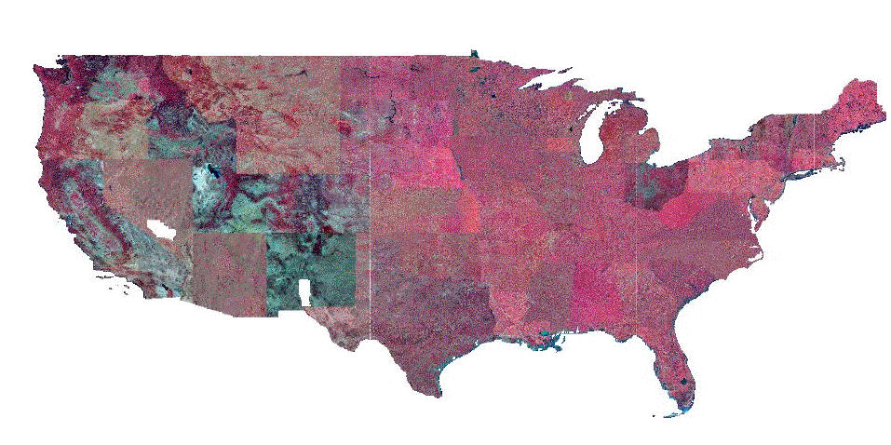
NAIP CIR
http://ncgcws.ftw.nrcs.usda.gov/ArcGIS/rest/services/ortho_imagery/NAIP_CIR/MapServer?f=jsapi

Slide 7
About the URL
Let’s back up a bit on the URL, from
To
Hostname
Instance
Protocol
Services

Slide 8
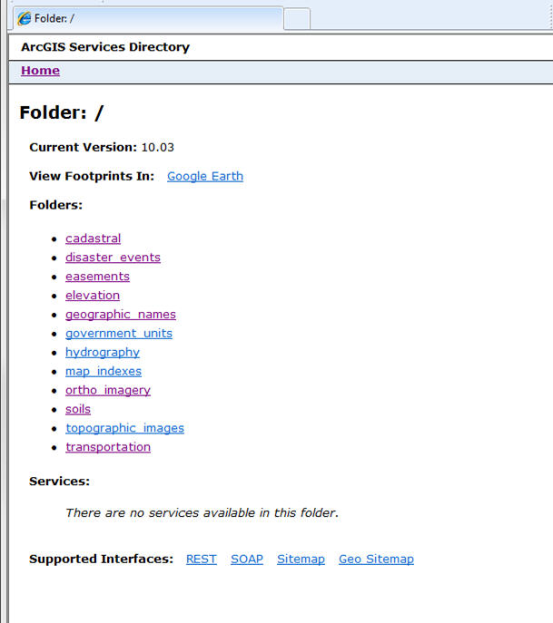
The services directory allows browsing of the contents of the server and to obtain information about the services.
Version of ArcGIS
A view of the geographic catalog that can be viewed in Google Earth. It is a downloadable kmz file.
Folders on this server containing services. Expressed as themes.
(Pretend F: Geodata)
Sitemap and Geo Sitemap are Google interfaces.

Slide 9
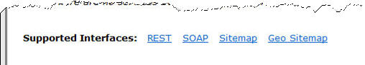
REST and SOAP Interfaces
These are both protocols for exchanging information through web services over a computer network.

Slide 10
SOAP
Simple Object Access Protocol (SOAP) is a specification to exchange information using Extensible Markup Language (XML).
Advantages: versatile, uses HTTP to tunnel through firewalls.
Disadvantages: slower.

Slide 11
REST
REpresentational State Transfer (REST) is more an architectural style that consists of clients and servers.
The client initiates requests to the server and the servers process the requests and return the appropriate response.
Advantages: lightweight, easy to build.
Disadvantages: no common standard. Up for certification at Open Geospatial Consortium (OGC).
Most common web service design is REST.

Slide 12
Just for Fun
A quick Google search for ArcGIS/rest/services:
http://gis.srh.noaa.gov/ArcGIS/rest/services
http://129.79.145.13/ArcGIS/rest/services/Maps/Weather/MapServer
http://services.nationalmap.gov/ArcGIS/rest/services/
http://www.geocommunicator.gov/ArcGIS/rest/services/

Slide 13
Web Services
A web service does not have to serve data that can be consumed by a GIS.
Twitter, Yahoo, Flickr, eBAY and Amazon all have web services that do not contain geospatial data.
This webinar will focus on the different types of Geospatial Web Services.

Slide 14
Geospatial Web Services
A map is created in ArcMap (mxd) and is then published to the Web creating a web map service (WMS).
The map, from the service, can be used in Web applications, ArcMap and other applications.

Slide 15
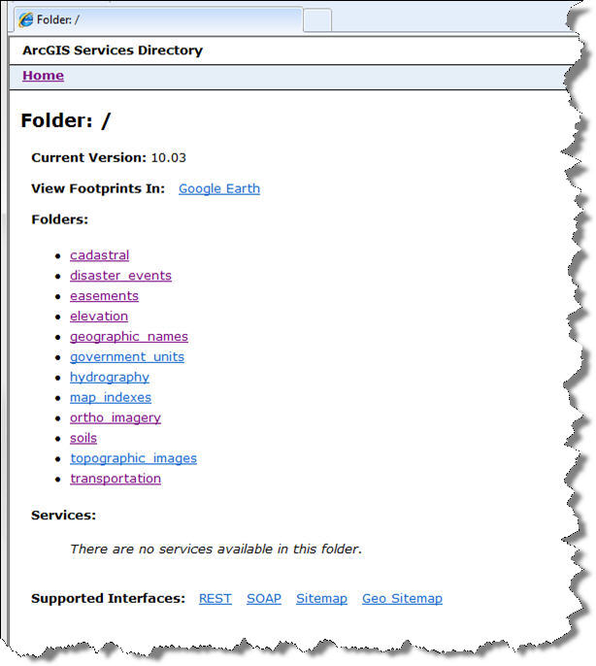
Web Map Service
The following URL displays this page of Folders.

Slide 16
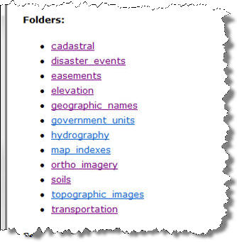
Folders
Each folder contains themes of web services.
There can be different types of services:
Map
Geoprocessing
Image

Slide 17
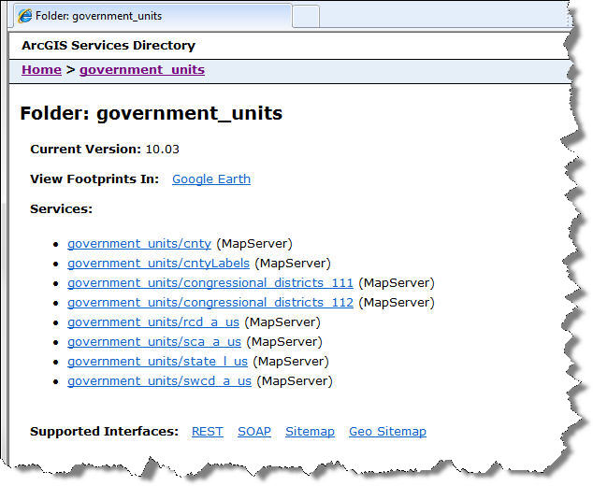
Folders
Services in the government_units folder

Slide 18
Naming Convention
Follow the USDA-SCA Geospatial Dataset File Naming Standard.
The standard file names convey as much information as possible:
dataset theme
type of map features in the dataset
Point (p), line (l), area (a)
spatial location or extent of the dataset
file extension (as applicable)
government_units/sca_a_us

Slide 19
Folders
_a means polygons, _l for lines. The _us denotes a service for the US

Slide 20
Folders
Select the map service

Slide 21
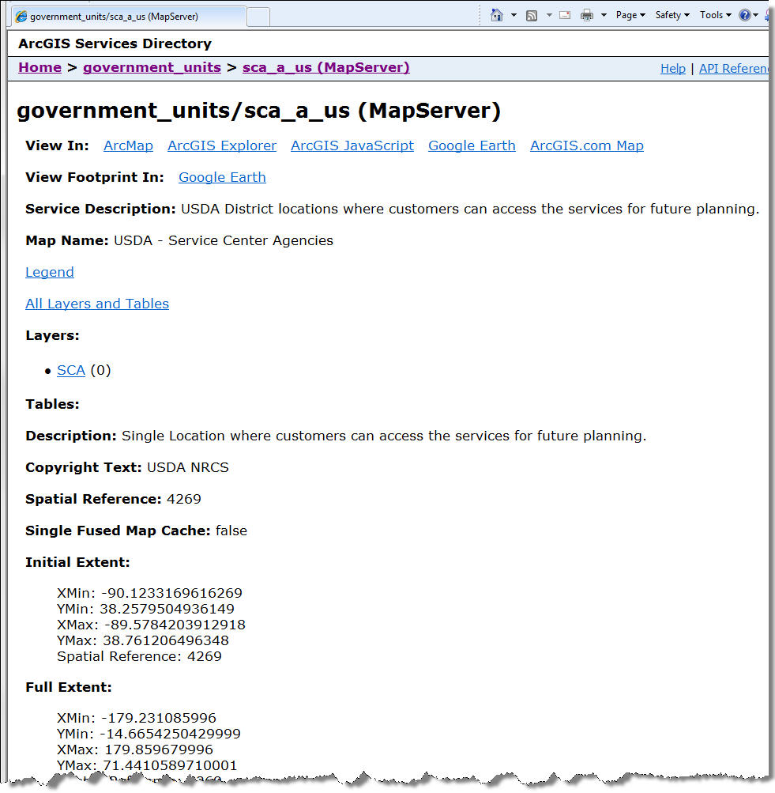
Government_units/sca_a_us
Applications to view the service in.
The intended use for the service.
Layers in this service.
http://spatialreference.org/ref/epsg/4269/html/
GCS NAD83

Slide 22
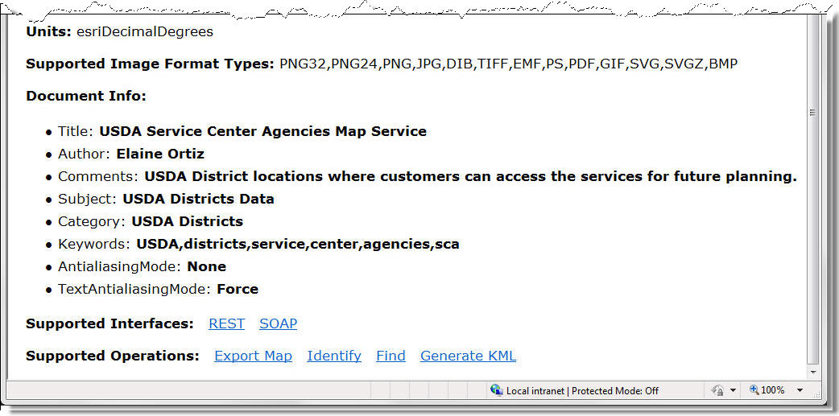
Government_units/sca_a_us
Units of the data
The operations that can be performed with this service.

Slide 23
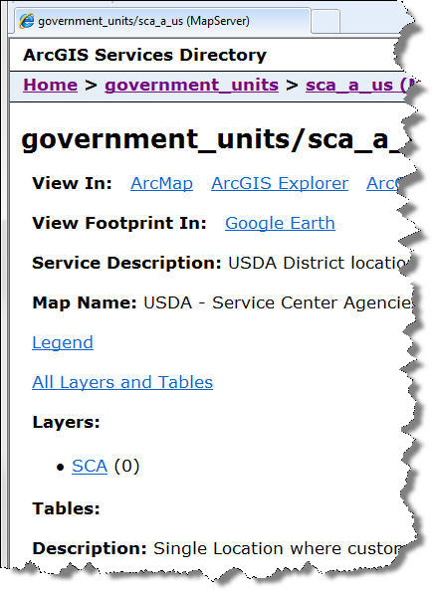
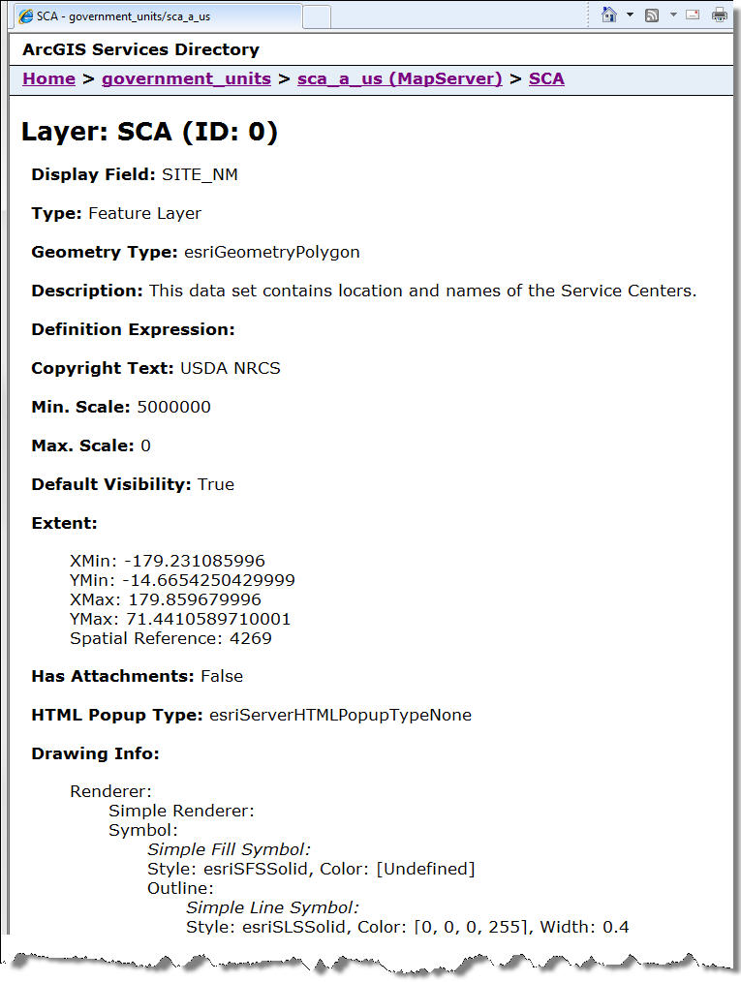
SCA Layer
The label that displays.
A vector polygon feature layer.
Select SCA

Slide 24
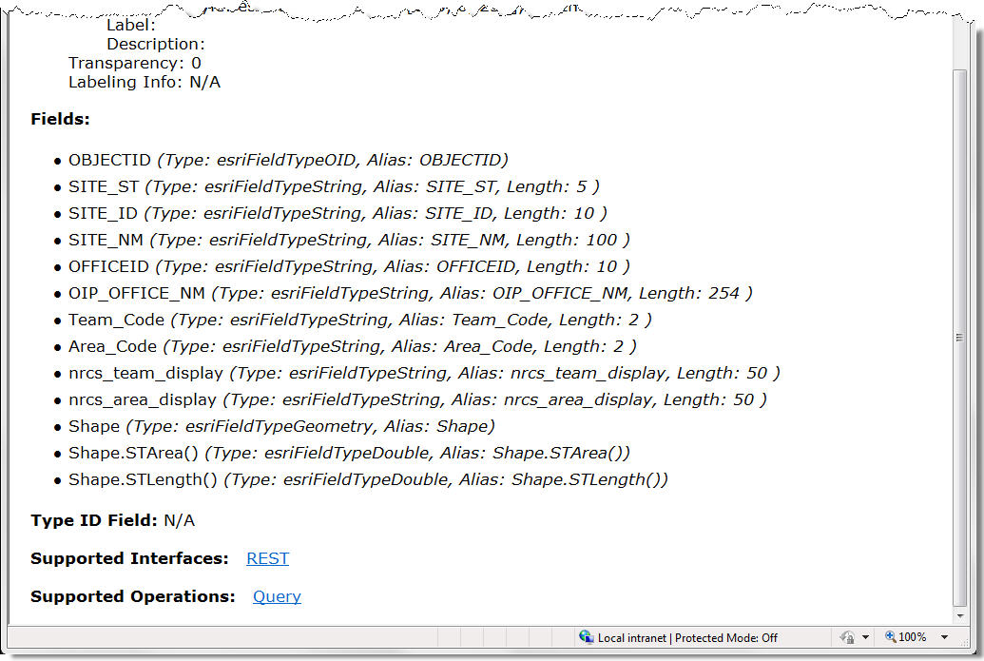
SCA Layer
All the fields contained in this feature layer along with the data type and alias.
Query can be supported on this layer.

Slide 25
What We Know about the SCA Layer
On host ncgcws in the government unit services folder.
Select sca_a_us layer:
What applications to view the data in
Description – District Locations
Projection - 4269 GCS NAD83
Supported Operations – Export, Identify, Find
Display Field - SITE_NM
Geometry Type - Polygon
All fields in the layer

Slide 26
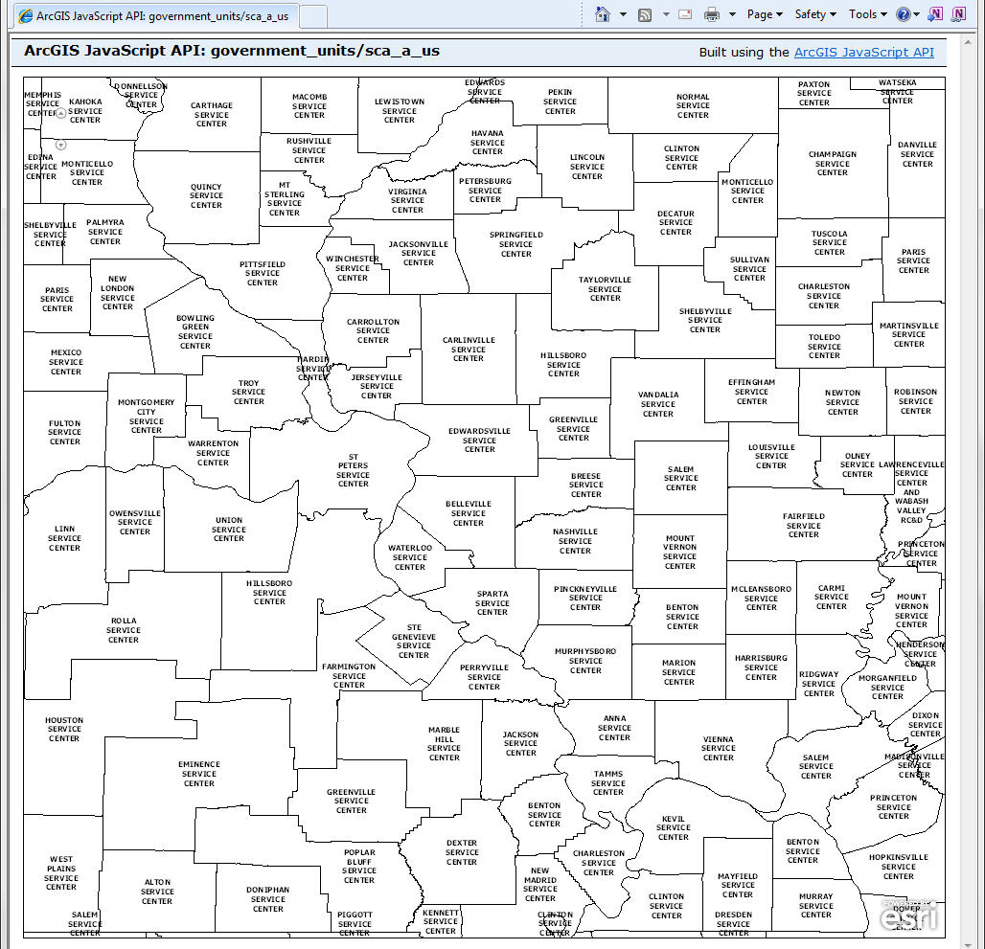
sca_a_us Layer

Slide 27
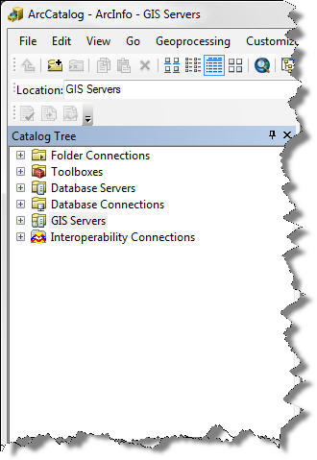
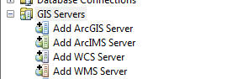
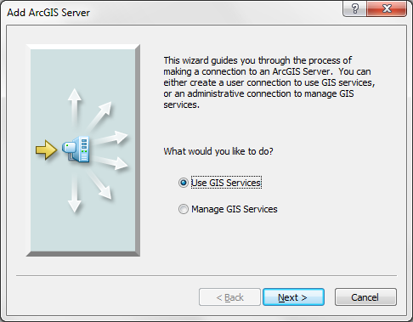
Adding the Service to ArcCatalog
2-Double –click Add ArcGIS Server
1-Expand GIS Servers
3-Default
4

Slide 28
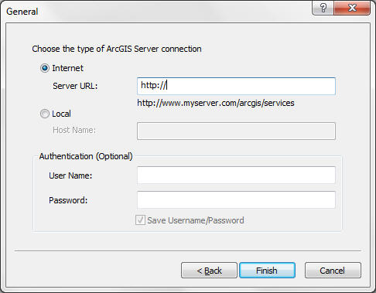
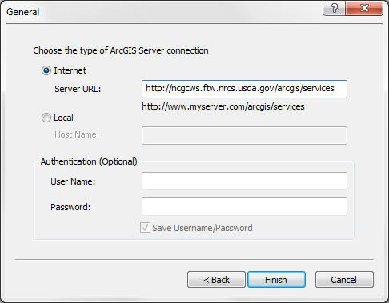
Adding the Service to ArcCatalog
Notice rest is not part of the URL.
5-Type URL
6-Finish

Slide 29
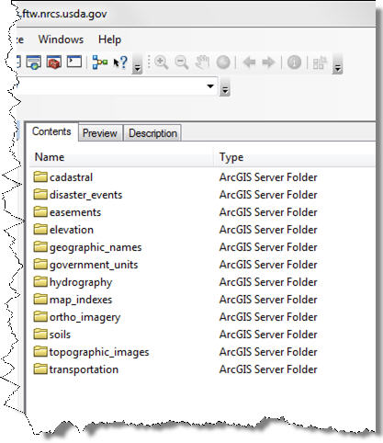
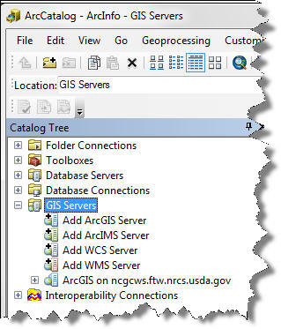
Adding the Service to ArcCatalog
Service added to Catalog Tree
Contents tab displays folders

Slide 30
Comparison
http://ncgcws.ftw.nrcs.usda.gov/ArcGIS/rest/services
ArcCatalog

Slide 31
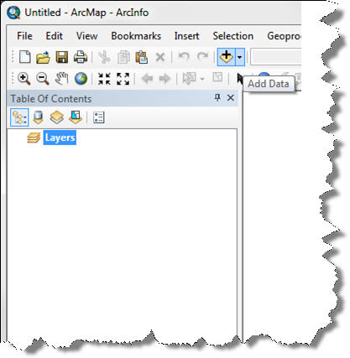
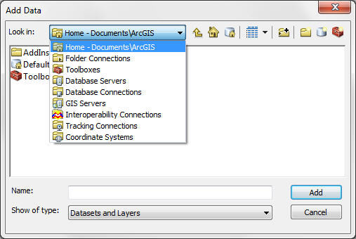
Adding the Data to ArcMap
1-Click the Add Data button
2-Select GIS Servers

Slide 32
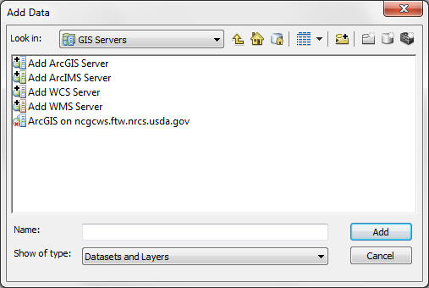
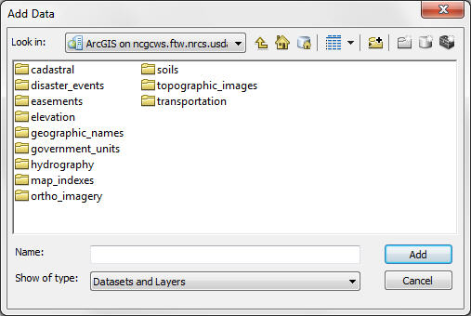
Adding the Data to ArcMap
3-Double-click the ncgcws service
4-Select the folder containing the service to add to ArcMap
The red “x” means the service is not connected

Slide 33
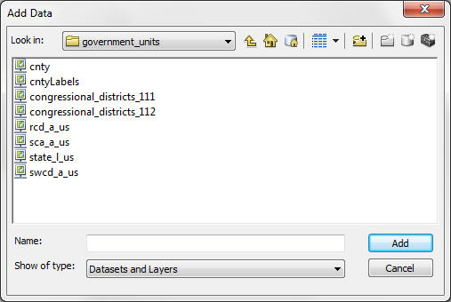
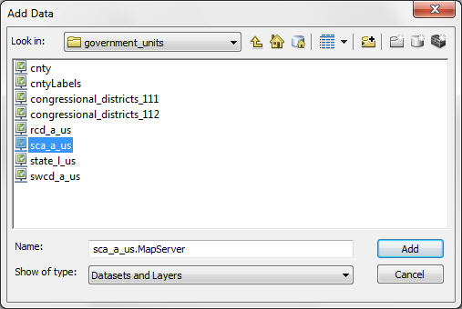
Adding the Data to ArcMap
government_units was selected
5-Select sca_a_us
6-Click Add

Slide 34
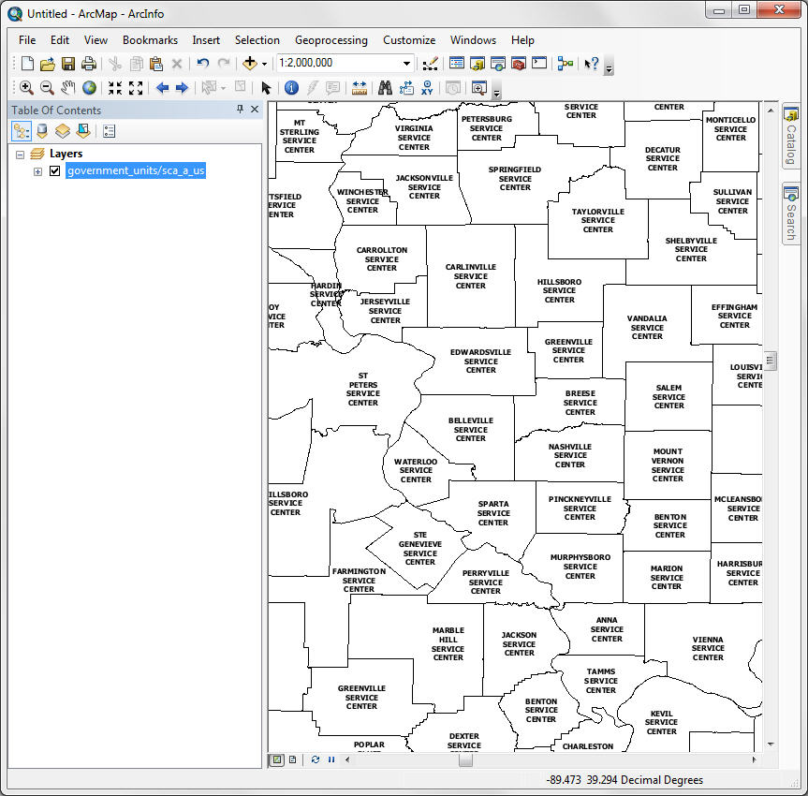
Adding the Data to ArcMap

Slide 35
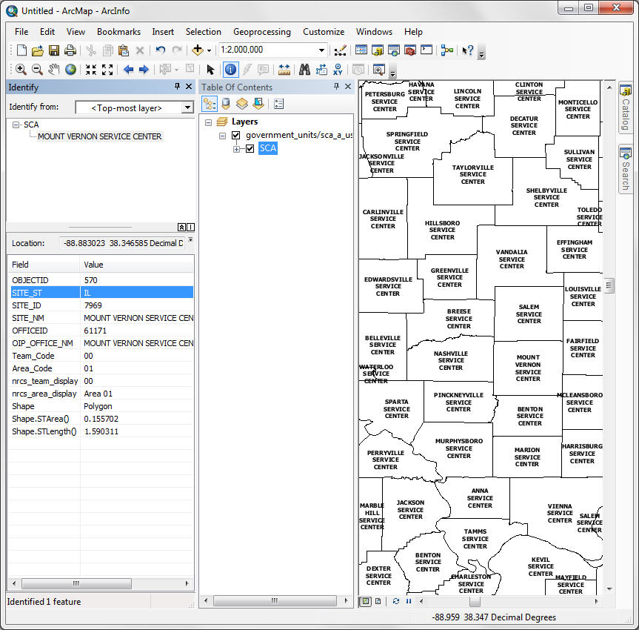
Supported Operations
Identify
Identify Results
Remember the operations supported by the service – Identify being one of those.

Slide 36
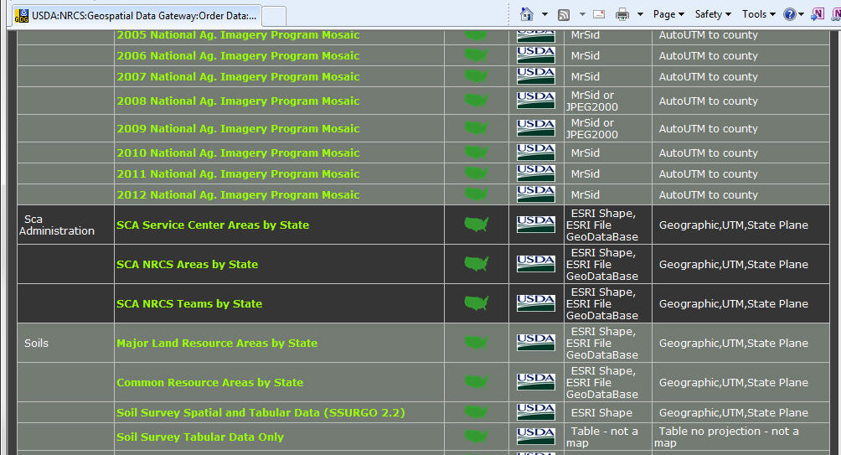
Downloading Data
If you need to do more with the data than just Identify and Export, download from the Geospatial Data Gateway.
The data can be downloaded from the service also.
http://datagateway.nrcs.usda.gov/

Slide 37
Other Data in the Services
You may run across data that have been built and altered for specific purposes.
Many times data are generalized for display speed.
This can help in locating a specific area in a US dataset quickly.

Slide 38
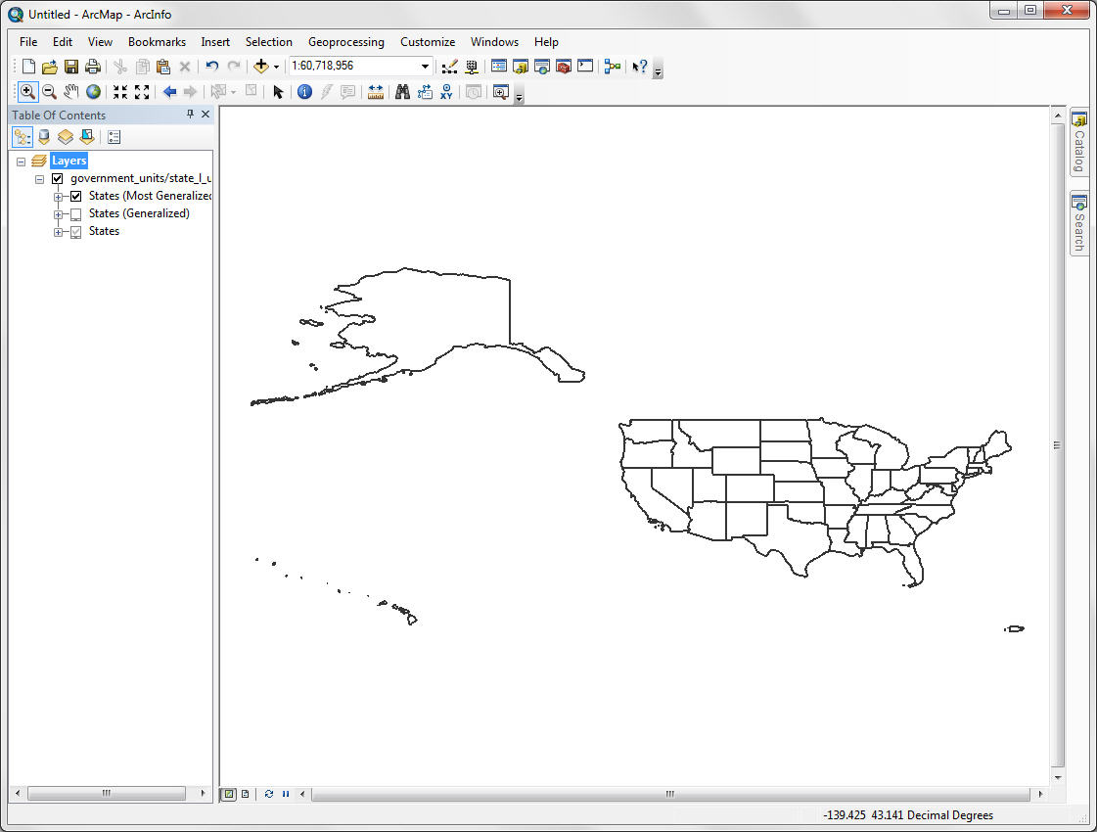
Generalized Maps
The layer is described as ‘Most Generalized’
Notice the scale of 1:60 million

Slide 39
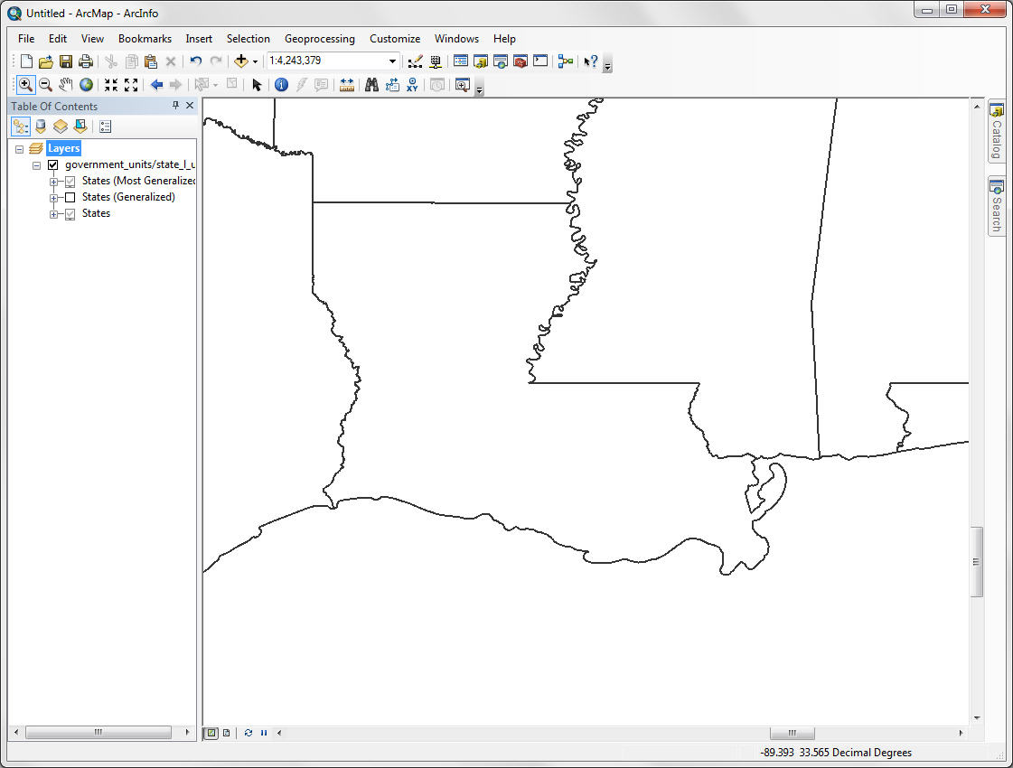
Generalized Maps
Notice the scale of 1:4 million
States ‘Generalized’
A generalized representation of the coast.

Slide 40
Geoprocessing Service
Contains geoprocessing tasks accessible by Web-enabled clients.
Tasks are created by publishing geoprocessing model and script tools.
Each tool in the toolbox becomes a task in the service.

Slide 41
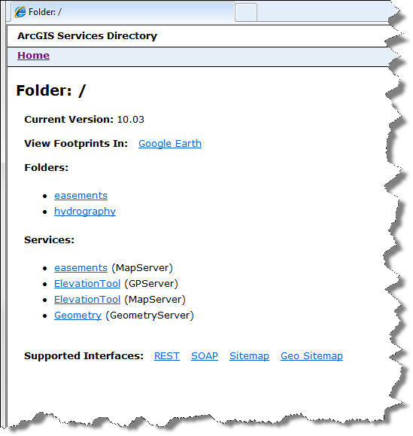
Geoprocessing Service
http://ngmcgp.ftw.nrcs.usda.gov/ArcGIS/rest/services/
NGMC would like to do more with geoprocessing services.
Something we will be investigating.

Slide 42
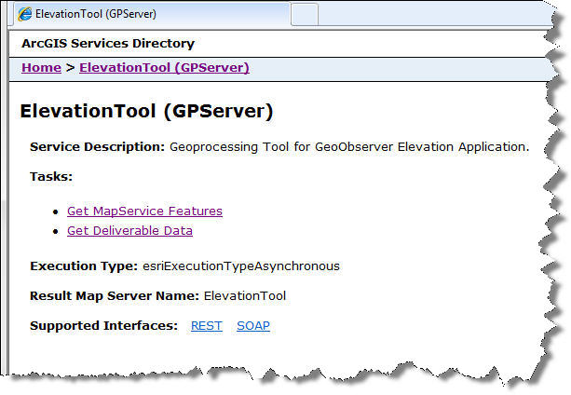
Geoprocessing Service
One of the requirements for a gp service is tasks.
What the tool is used for.
Name of the task.

Slide 43
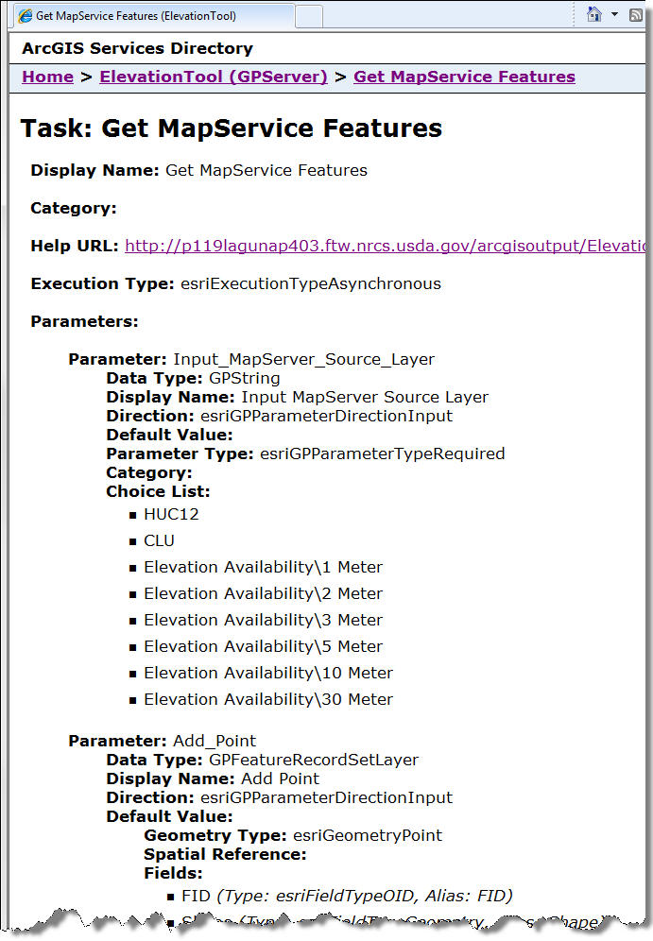
Geoprocessing Task
Choose a source layer.
Add a point on the chosen source layer.

Slide 44
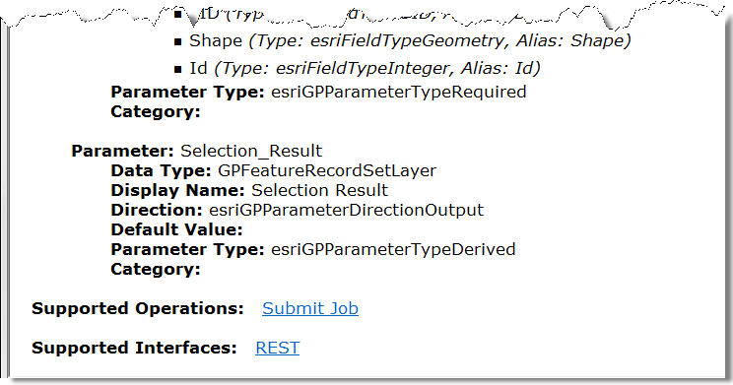
Geoprocessing Task
Result

Slide 45
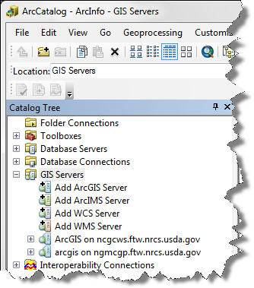
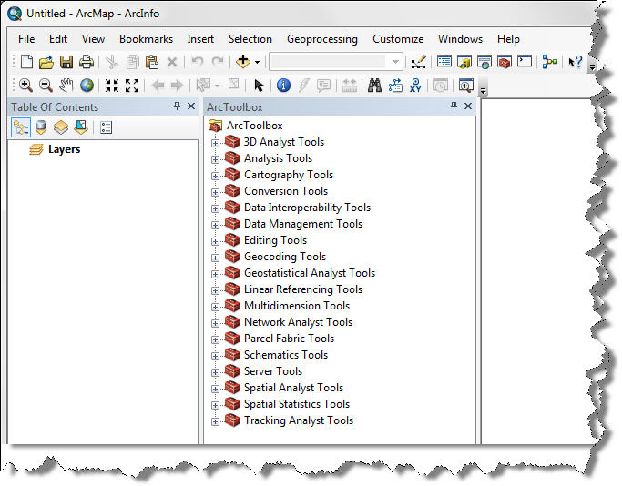
Add the Geoprocessing Service
2-Open ArcToolbox
1-Add the geoprocessing service

Slide 46
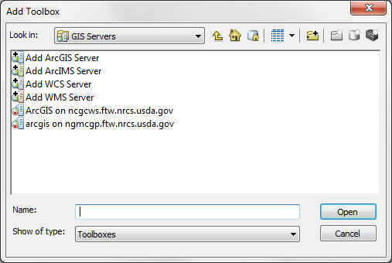
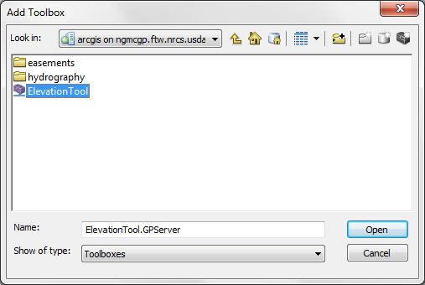
Add the Geoprocessing Service
4-Select Elevation Tool
3-Double-click on ngmcgp
5-Click Open

Slide 47
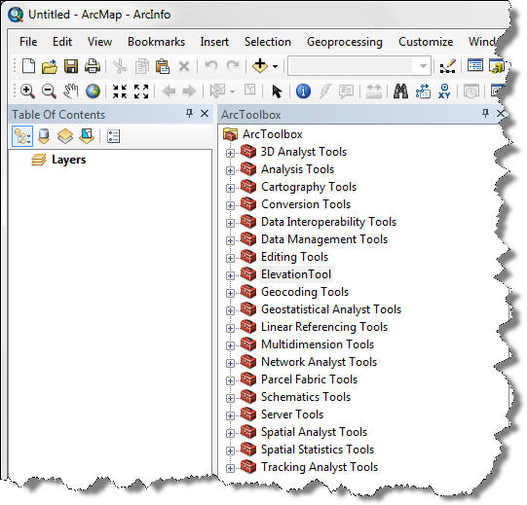
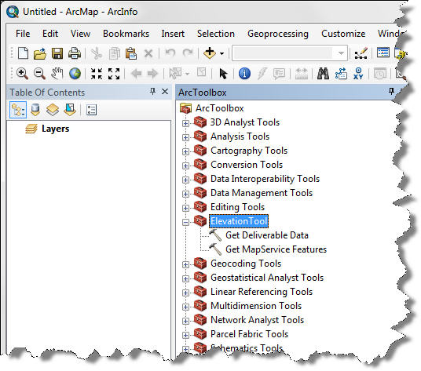
Add the Geoprocessing Service
Elevation Toolbox is added
6-Expand the Toolbox

Slide 48
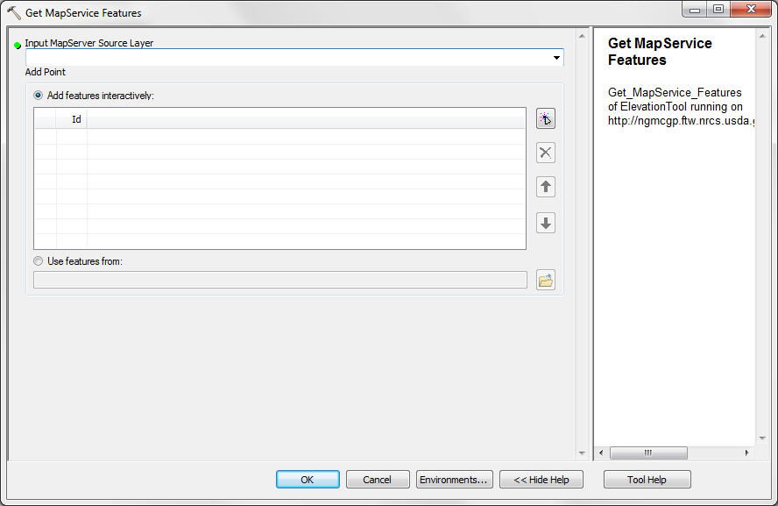
Add the Geoprocessing Service
8-Input parameters to run tool
7-Double-click ‘Get MapService Features’

Slide 49
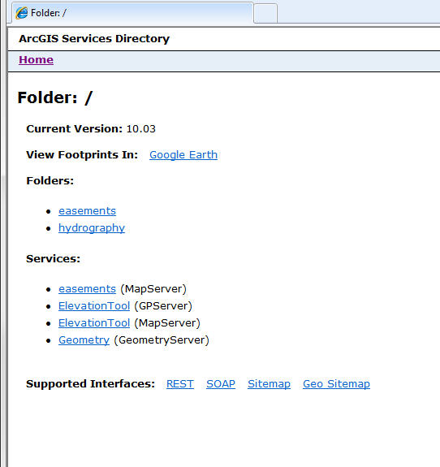
Geometry Service
Helps applications perform geometric calculations such as buffering or projecting.

Slide 50
Other Web Services
A Feature Service enables editing on a layer:
NGMC has 1 WFS that is being tested
A Geocode Service allows for finding and displaying of addresses on a map.
There are also geodata services, globe services, KML services, mobile services supported with ArcGIS Server.
NGMC does not offer any of these services.

Slide 51
Hosts
The ncgcws host contains public web services.
NGMC has other hosts that you may come across.

Slide 52
Other Hosts
http://gdwweb1.ftw.nrcs.usda.gov/ArcGIS/rest/services
http://imageserver1.ftw.nrcs.usda.gov/ArcGIS/rest/services
http://imageserver2.ftw.nrcs.usda.gov/ArcGIS/rest/services
Not an inclusive list.

Slide 53
Services
There are approximately 200 web services at NGMC.
Some of the 200 services are duplicates:
Still supporting ArcGIS 9.2
Many of the ArcGIS 10 services are in the Web Mercator projection
Web Mercator is not supported until ArcGIS 9.3.1
A Web Mercator service will crash ArcGIS 9.2

Slide 54
Other Hosts and Services
If the host name or service has test anywhere in the name then do not use in your map.
Some of the 200 services are tests
Testing various options of the data and services
It can be confusing to have both test and production services on the same host
NGMC is working on having enough room to do both production and testing on separate hosts
We are having the same experiences you are, “Doing more with less”.

Slide 55
Image Services
Provides access to raster (and image) data.
Requires a raster or mosaic dataset.
Can be used in ArcGIS Desktop.
There are approximately 100 image services at NGMC.

Slide 56
Map vs. Image Service
A map service requires an mxd.
An image service does not.
Serving image (raster) data through a map service requires an mxd
This will slow the rendering of imagery data
This will not slow the rendering of vector data
Serving image data through a image service does not require an mxd, can consume directly
This will speed the rendering of the data
Old (map service) vs. new (image service).

Slide 57
Image Service
In order to use the image service in ArcMap the Image Server Plugin must be installed in ArcGIS 9.2 and 9.3.

Slide 58
Image Server Plugin
The image server plugin is available for download and installation for ArcGIS 9.2 and 9.3:
It is CCE Certified
There are separate plugins for 9.2 and 9.3
Contact your local ITS
The plugin is provided in ArcGIS 9.3.1 and 10.0.

Slide 59
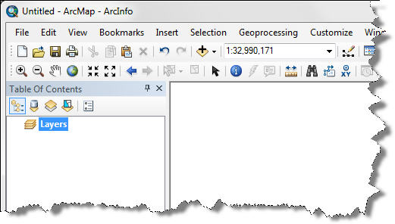
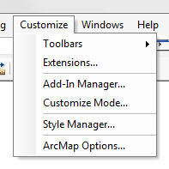
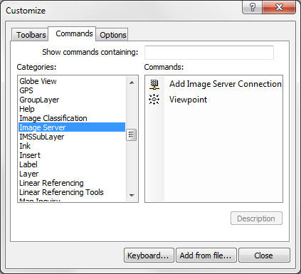
Adding the Plugin to ArcMap 10
1-Select Customize
3-Select Commands
2-Select Customize Mode
5-Select Add Image Server Connection
4-Select Image Server

Slide 60
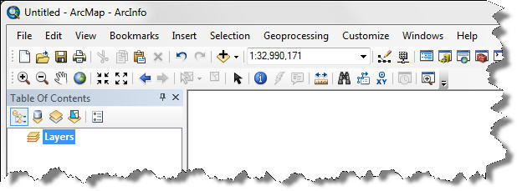
Adding the Plugin to ArcMap 10
7-Release left mouse button
6-Left click and drag to ArcMap toolbar
8-Close

Slide 61
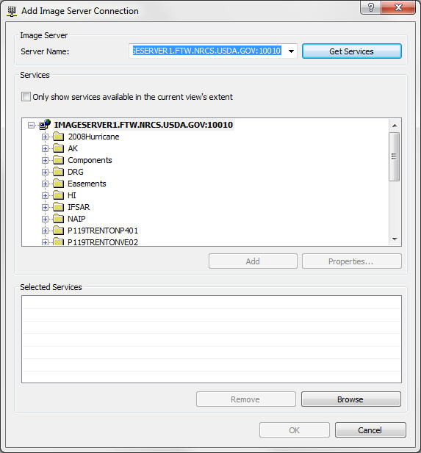
Adding Image Service Data to ArcMap
2-Type imageserver1.ftw.nrcs.usda.gov:10010
1-Select Add Image Server Connection button
3-Click Get Services
Services available on imageserver1

Slide 62
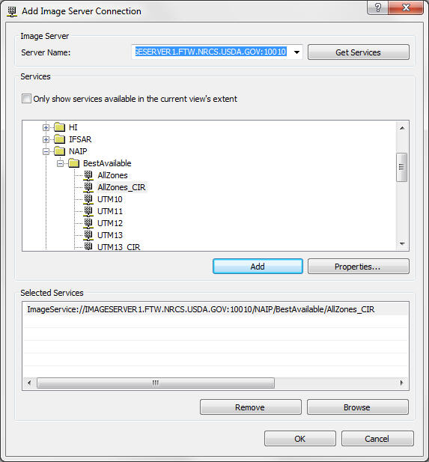
Adding Image Service Data to ArcMap
4-Expand
5-Select
6-Add
Can add more than one service at a time, just keep selecting and adding.
7-OK

Slide 63
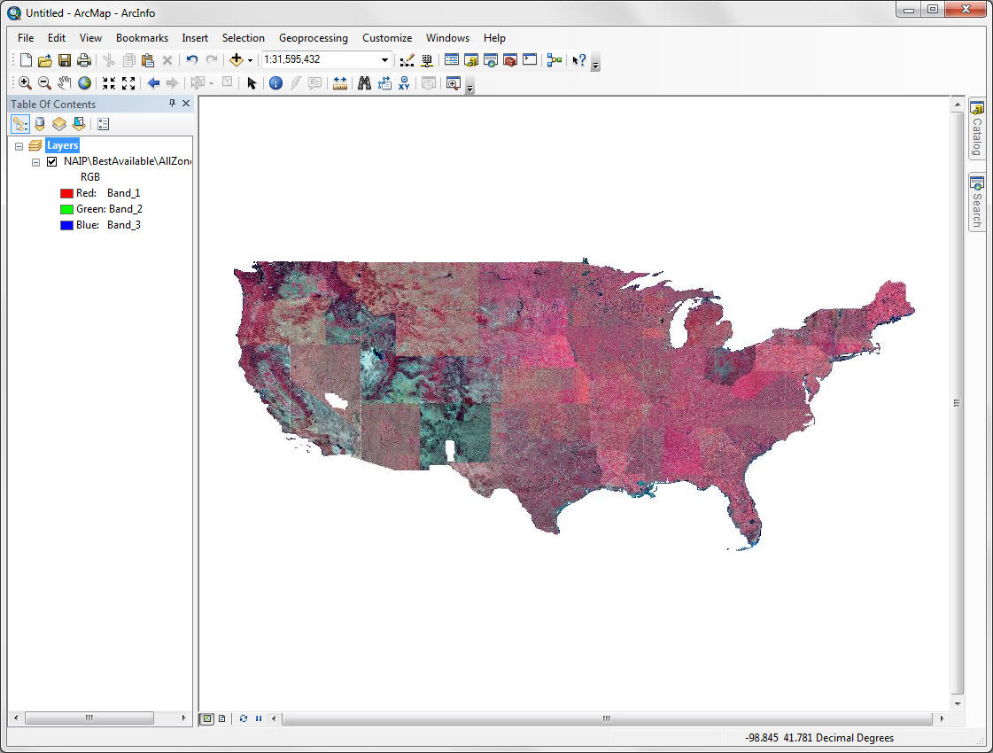
Adding Image Service Data to ArcMap

Slide 64
Map vs. Image Service
A map service requires an mxd.
An image service does not.
Serving image (raster) data through a map service requires an mxd
This will slow the rendering of imagery data
This will not slow the rendering of vector data
Serving image data through a image service does not require an mxd, can consume directly
This will speed the rendering of the data
Old (map service) vs. new (image service).

Slide 65
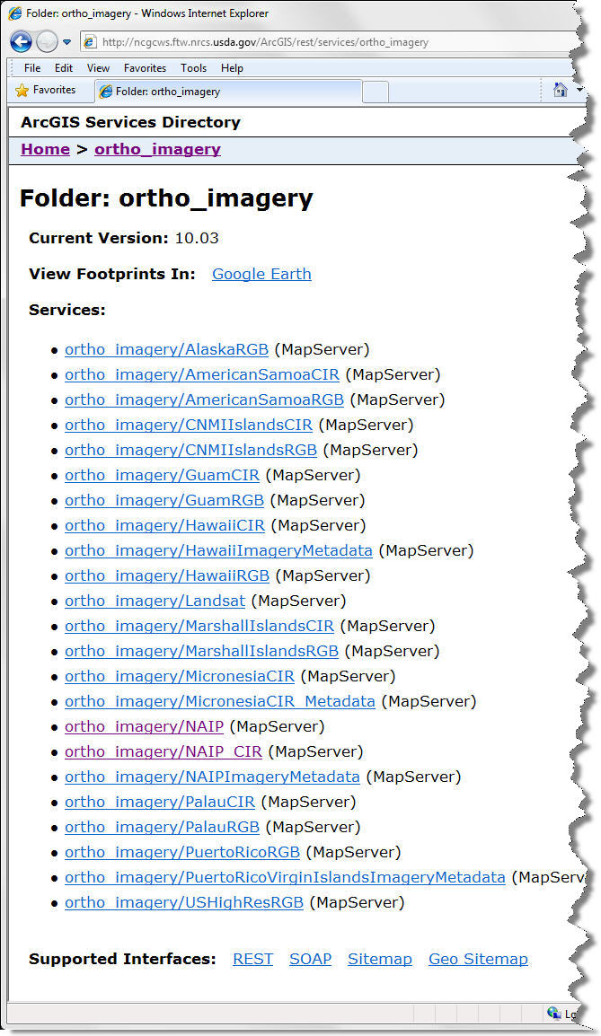
Image vs. Map Service
Images served through a map service on ncgcws.
A map service because it requires a mxd.
Renders more slowly for imagery data not vector data.
The map services are used mainly to support those clients in ArcGIS 9.2.

Slide 66

Image vs. Map Service
Images served through an image service on imageserver1.
An image service because it does not require an mxd.
Renders faster.

Slide 67

Image vs. Map Service
Map Service
Same data
Image Service

Slide 68
What’s Coming
In ArcGIS 10.1 image server is being replaced by something called mosaic datasets:
More testing services will appear when NGMC begins implementing
More duplicate services also to continue supporting ArcGIS 9.2, 9.3, and 10.0

Slide 69
Caching Service
A map cache is the entire map at several different levels or scales.
The cache also stores the copies of the map images.
Map caching is a very effective way to make maps and applications run faster.
It can take a while to create the cache but the benefits are performance and quality.

Slide 70
Caching Service
A cache tiling scheme must be created.
The cached images are no longer in a GIS format, instead they become a picture in either JPEG or PNG format.
JPEG usually used for imagery.
PNG format is used for any feature that requires transparency (opacity).
A service can have a mix of JPEG and PNG formats.

Slide 71
Levels of Caching
Most of the image services have approximately 14 to 18 levels.
The levels can differ depending on the data and the intended use of the data.

Slide 72

Cached Maps
Back to ncgcws.ftw.nrcs.usda.gov. Select easements.
Select

Slide 73

Cached Maps
A good description of the service.
Imagery from 2007.
Spatial Reference 4326=WGS84

Slide 74

Cached Maps
9 levels of detail.
Each level has a scale.
Format = Mixed (Both JPEG and PNG).

Slide 75
Cached Maps
The NAIP imagery collection:
Entire US
The year is not important as not every state is collected each year
4 band
1 meter resolution
35 terabytes (TB) of raw data
1 terabyte = 1024 gigabyte

Slide 76
Cached Maps
Each increase in levels or scale (ex: 24,000 to 12,000) increases the storage by a factor of 4.
Also increases the time to produce by 4.
It takes 4 times longer to produce caches at 12,000 than 24,000 and takes 4 times the storage space to store tiles at 12,000 than 24,000 scale.
Another way to describe ‘cost’.

Slide 77
Cached Maps
Caching allows for the data to be compressed
35 TB to 4 TB with caching
4 TB includes 17 levels with the final level at 1.2 meter resolution.
However, 4 TB of NAIP + 4 TB of NAIP CIR.
Still, 8 TB is less than 35 TB.

Slide 78
How Do We Remember All These Hosts?
Instead of trying to remember all the different URLs NGMC has tried to collect all the services in one spot – GeoPortal:
http://ncgcweb.ftw.nrcs.usda.gov/geoportal/catalog/main/home.page
Allows searching by theme
GeoPortal is a work in progress
Doing more with less

Slide 79

GeoPortal

Slide 80


GeoPortal
Select State Boundaries Map Service
Select Data Themes

Slide 81

GeoPortal
Select Open

Slide 82

GeoPortal
Select Preview

Slide 83

GeoPortal
Select Details

Slide 84

GeoPortal
Select Metadata

Slide 85
Web API
A web API (Application Programming Interface) is a set of HTTP requests along with responses usually expressed in XML.
The advantage of a web API allows for the combination of multiple services into a new application known as a mashup.
Microsoft Silverlight is an example of an API.

Slide 86
Web API
Very quick to stand-up.
NGMC uses Silverlight to supply imagery for disaster areas.
In 2011 Hurricane Irene, Mississippi and Missouri River Flooding.
The services will be turned off eventually.
Only available within the USDA network.

Slide 87

Missouri River Disaster Service

Slide 88

Missouri River Disaster Service
Check for Visible
Imagery on different dates
Transparency Slider

Slide 89

Missouri River Disaster Service
A list of all the layers in the service

Slide 90
What’s Coming for Services
Elevation (LiDAR) Services
6 TB of data and growing daily
Do it yourself, publish your own web service
We hope – doing more with less

Slide 91
Future Plans for the Services
The services are currently hosted at NGMC.
All the services will move within the next year.
Yes, the URLs will change and there isn’t any way to prevent that.
Why?

Slide 92
Federal Data Center Consolidation
Fort Worth data center is scheduled to close at the end of 2013 fiscal year:
This is not the same as the National Geospatial Management Center
The Fort Worth office is not closing
Only the data center (hardware, software, services) are closing
For more information about the Federal Government Data Center Consolidation Initiative visit
https://explore.data.gov/Federal-Government-Finances-and-Employment/Federal-Data-Center-Consolidation-Initiative-FDCCI/d5wm-4c37?

Slide 93
Where are the Web Services Moving to?
Most likely the National Information Technology Center (NITC) in Kansas City.
http://www.ocio.usda.gov/nitc/index.html
Why here and not somewhere commercial?
The answer to that is FISMA.

Slide 94
FISMA
Federal Information Security Management Act of 2002 (FISMA).
Recognizes the importance of information security.
“Requires each federal agency to develop, document, and implement an agency-wide program to provide information security for the information and information systems that support the operations as assets of the agency, including those provided or managed by another agency, contractor, or other source.”

Slide 95
FISMA
Defines 3 levels of potential impact on organizations or individuals should there be a breach of security.
The impact levels are low, moderate and high.
OCIO must make a determination of the impact level of your data.
The storage solution provider must have matching certification
If the data have moderate potential impact the storage provider must be FISMA moderate certified

Slide 96
FISMA
OMB requires government data to be stored at a FISMA certified location
It’s called Authority to Operate (ATO)
Currently only 3 FISMA certified locations:
NITC in Kansas City
NFC in New Orleans
NASA (I’m not sure where)

Slide 97
FISMA
The law requires each federal agency to develop, document…
Yes, Amazon and Google cloud services may be FISMA certified, but for what Agency?
Amazon had FISMA certification, but for only one Agency and only on one application.
The certification has since expired.

Slide 98
FISMA
Unfortunately, we cannot make commercial solutions become FISMA certified.
It may not be in their business model to jump through all the government hoops.

Slide 99
FedRAMP
Federal Risk and Authorization Management Program is a government-wide program that provides a standardized approach to security assessment, authorization, and continuous monitoring for cloud products and services.
Trying to get away from each Agency shall…
Making progress, but slowly.

Slide 100
What is a Cloud?
The use of hardware and software resources that are delivered as a service over a network, usually the Internet.
Clouds usually use REST-based APIs.
Several types of cost models.
Commercial vendors usually provide only racked storage and the customer provides much of the other services.

Slide 101
Cloud Services
Cloud services require:
Storage pricing
Data transfer pricing:
Adding NAIP 2013, new LiDAR data, etc.
Data are not static
Backing up the data
Who patches for Security vulnerabilities?
Not an inclusive list

Slide 102
An Exercise
Amazon pricing
First TB/month $0.125 per GB
Next 49 TB/month $0.110 per GB
NITC pricing
$0.88/month per GB
1 TB = 1024 GB
4 TB of NAIP = 4096 GB
1024 * $0.125 + 3072 * $0.110 = $466/month * 12 = $5591/year (Amazon)
4096 GB * $0.88 = $3604/month * 12 = $43238/year (NITC)

Slide 103
An Exercise
4 TB NAIP + 4 TB NAIP CIR + 6 TB LiDAR = 14,336 GB * $0.110 = $1,576/month * 12 = $18,912/year
14,336 GB * $0.88 = $12,615/month * 12 = $151,388/year
14 TB is not all the data!
This is only the storage cost and does not include other costs.
Please note that these prices change regularly and were accurate as I knew them on 9/27/2012. Prices may be different tomorrow.

Slide 104


Make a Map from Services
Select Imagery
Select Add Basemap
Click Add

Slide 105

Make a Map from Services

Slide 106

Make a Map from Services
Turned on Boundaries and Places
I zoomed in while you weren’t looking.

Slide 107

Make A Map from Services
Searched for soils
Click Add
Select Add Data from ArcGIS Online

Slide 108

Make A Map from Services
The Fort Worth Federal Center Building 23 National Geospatial Management Center.
Can you see me waving BYE?!
Added a Soils service from ESRI that displays the Dominant Order
Zoomed in a little more

Slide 109
Got Questions?
Send them in via the LiveMeeting Q & A link.
Jennifer.Sweet@ftw.usda.gov
817-509-3421

